Slide 1
HTML History
CS 101

Slide 2
HTML
Stands for Hypertext Markup Language
A “Markup Language” dates from the early days of publishing when editing was done manually
An editor (a person!) would take a manuscript from an author that was to be printed, and put marks on the paper that told the printer (another person!) how the document should be arranged on the page

Slide 3
HTML (continued)
The marks on the page indicated where pictures were to be inserted, where a new page should be started, margins, font sizes, etc.
Generally the marks affected the appearance of the text, not the content
See “Proofreaders’ marks” for examples

Slide 4
Hypertext
Concept of different documents linked together had many roots
As long ago as 1945, it was described in futuristic terms
1963, Ted Nelson coined the term hypertext “linked content”
1987 Apple released HyperCard for the Mac
All these were before networks were prevalent, mostly concerned with documents on one machine

Slide 5
HTML (continued)
In 1990 Tim Berners-Lee, a computer scientist at CERN (European center for nuclear research) wanted to help people share information on the early Internet
Wanted it to be easy! Not just for computer scientists
He imagined a graphical interface that would link documents together across a network

Slide 6
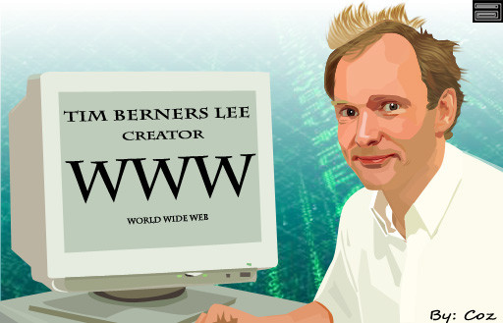

Sir Tim Berners-Lee

Slide 7
HTML philosophy
Originally the idea was that HTML was “browser agnostic” or “platform agnostic”
Was designed to work on any device or browser
Decisions on how to display something was left as much as possible to the browser, which knew about the local machine = RAM, display and graphics, pointing devices, etc.

Slide 8
“Agnostic”
So the HTML tags did not specify colors – some displays were monochrome
Did not specify fonts – might not be installed on the machine
Unfortunately this standard did not last
Witness the difficulty of viewing many sites with smart phones/mobile devices with tiny screens and/or touch screens

Slide 9
Browser Wars
Tim Berners-Lee wrote the first “Web browser” – not widespread
Marc Andreessen wrote Mosaic, one of the first popular browsers
Andreessen formed company and created the Netscape browser (1994) very popular
Microsoft came out with Internet Explorer to compete with Netscape, free with Windows

Slide 10
Browser Wars (continued)
Netscape was made open source and provided by Mozilla company, but eventually could not compete with Microsoft (died 1998)
Mozilla created Firefox browser (as well as Thunderbird email client)
Other browsers: Opera began as research project at Norwegian telecomm company in 1994
Chrome 2008 by Google, Safari by Apple 2003

Slide 11
Browser wars (continued)
How do browsers compete?
One way is by changing the way they interpret HTML so it is not quite following the standard
If the browser gets enough market share, it can become a “defacto standard”
Web developers will make sure their pages are compatible with the way that browser displays HTML pages

Slide 12
Phishing
The term refers to fooling people into clicking links that they should not.
The links lead to pages/forms that try to get information from you: name, passwords, addresses, bank account info
Usually in order to steal your identity
Watch your URLs! check before you click!

Slide 13
Cookies
When e-commerce started, developers realized that pages had no “long-term memory”.
If you picked some items from a catalog page, when you went to the next page, your choices were forgotten.
They use a small file stored on YOUR machine to record things like this.

Slide 14
Cookies
This file is called a cookie.
It is a convenience – you don’t have to log in, it remembers your location for your forecast, etc.
But unscrupulous companies can ask for permission to access their cookie left on your machine, but then read ALL the cookies!
They are looking for useful info like accounts and credit card numbers!
Every browser has a way to turn cookies off, or to ask before allowing a cookie. Think about it!

Slide 15
References
http://www.webwritingthatworks.com/ERantCONTENT02.htm Nice short description of Markup, HTML and XML
http://www.livinginternet.com/ Detailed history about the Internet
http://www.w3schools.com/html/default.asp The best tutorials for learning HTML

